Slide 1
LAND USE CHANGE, WATER AVAILABILITY AND ADAPTATION STRATEGIES IN CHANGING AND VARIABILE CLIMATE IN KAJIADO NORTH, KENYA
By
Mtisunge Mngoli

Slide 2
BACKGROUND
Water is an important resource as both social and economic activities depend on water (World Bank, 2006
Climate change, increase in population and change in land use have resulted in water resources degradation which has made people food insecure.
Agriculture is the mainstay of the country’s economy contributing 29% of Kenya’s GDP and about 80% of Kenya’s population is employed in the sector, (UNICEF, 2008).

Slide 3
Background cont..
Rainwater harvesting has been proved to be a sufficient water supply during water restrictions for household needs in Kenya and it is a form of managing risks during weather variability, (Aroka, 2010)
However rainwater harvesting has not been utilised to its full potential
Kajiado North is one of the peri-urban areas of Kenya in desperate need of clean and safe water for agricultural production

Slide 4
JUSTIFICATION
Climate change and land use change have reduced the agricultural yield in Kajiado North because it is putting pressure on water resources
With the increase in population doubling every year, if the water problem is not addressed there is going to be a tremendous decrease in agriculture production and other income generating activities.
Although many programs and projects in Kenya aim to modernize agriculture and double the food supply by emphasizing on different mechanisms, most of the technologies are often not customized to meet the needs and present conditions of smallholder farmers who are the majority of the population.

Slide 5
OBJECTIVES
Overall objective
To contribute towards alleviating water scarcity through promoting rainwater harvesting and sustainable water conservation measures in Kajiado North, Kenya
Specific objectives
To determine the magnitude and pattern of land use changes that have occurred in the past 20 years
To assess the effect of climate change and variability on water resources
To assess the perception of rainwater harvesting as a coping strategy to climate change and variability

Slide 6
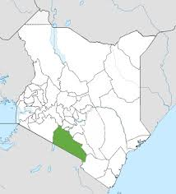
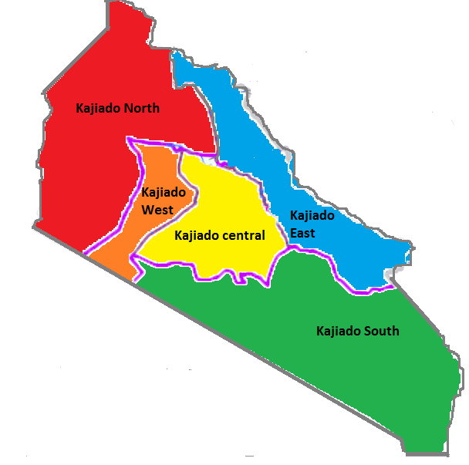
METHODOLOGY
The study was conducted in Kajiado County in Kajiado North constituency

Slide 7
RESULTS AND DISCUSSION
Magnitude and pattern of land use changes occurred in the past 20 years
Results from PGIS maps revealed significant increase in settlement of 3.75% from 1990-2000 and 6.5% from 2000 to 2010 and a significant decrease in grassland of 4.6% from 1990 to 2000 and 7.2% from 2000 to 2010.

Slide 8
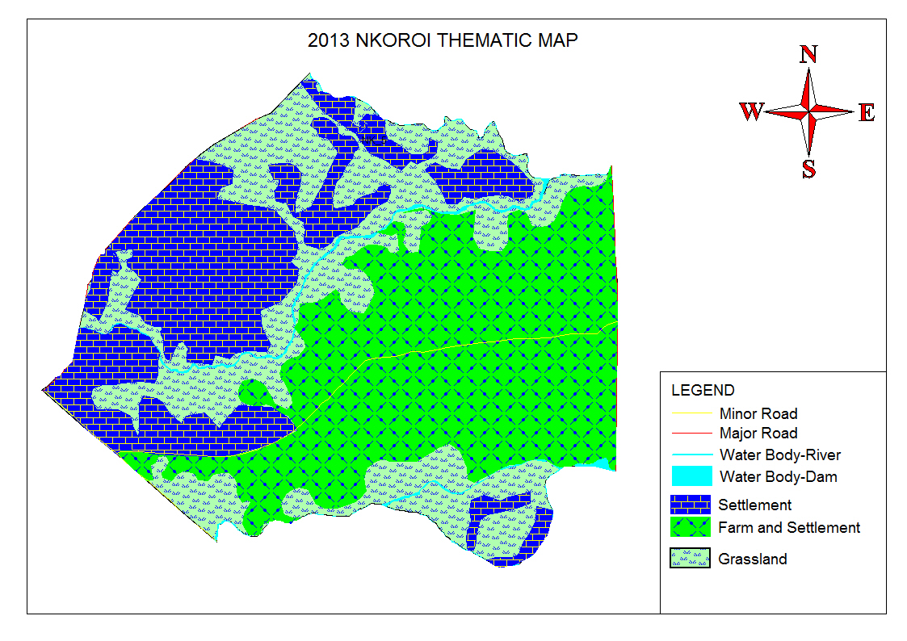
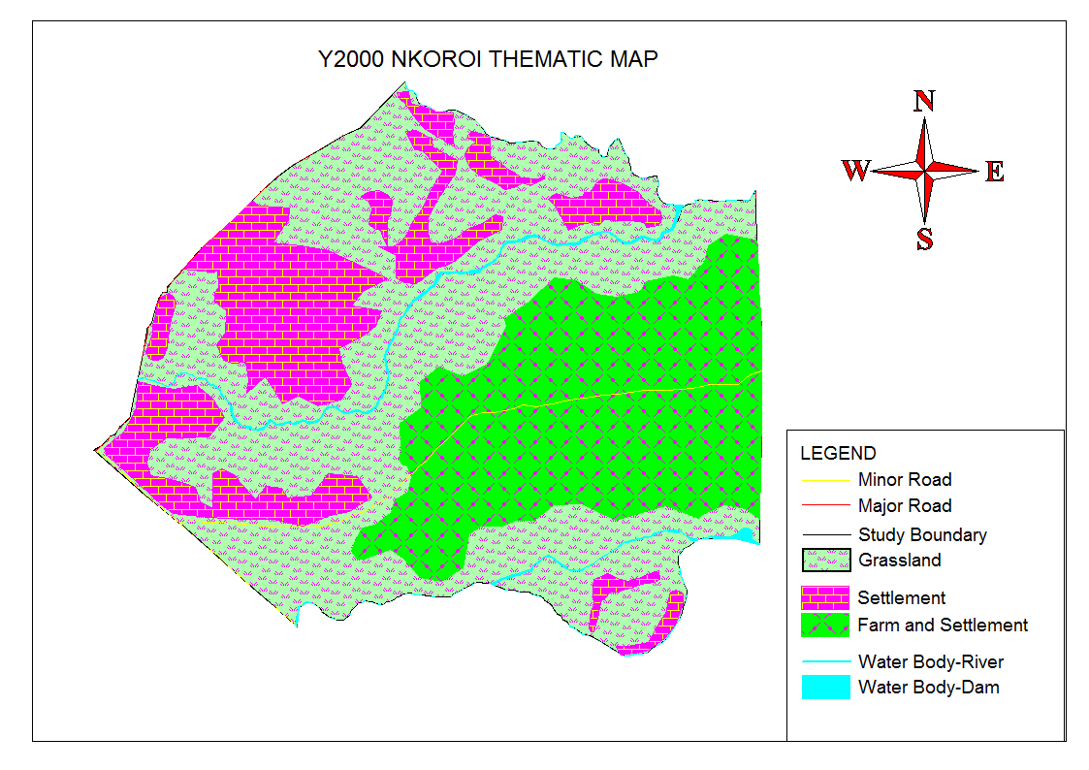
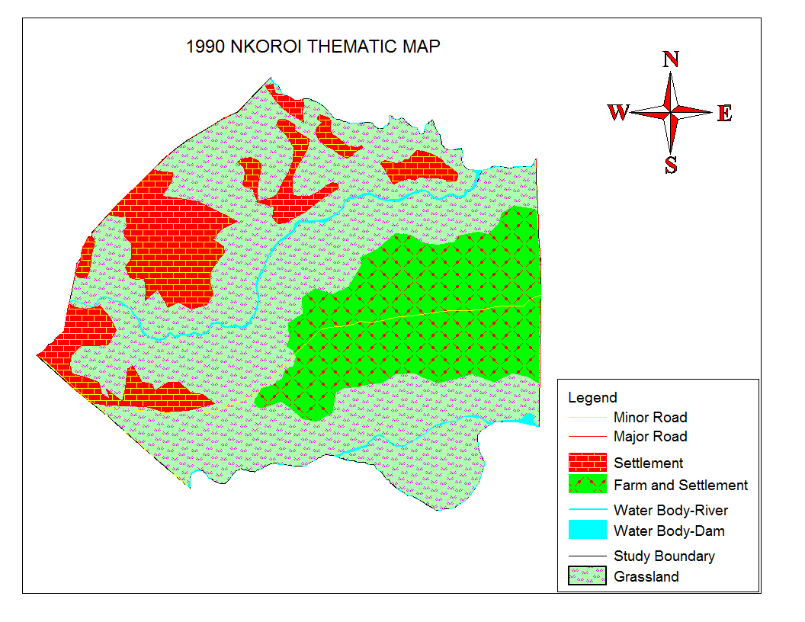
Map of Nkoroi sub location showing changes in land use (a) 1990, (b) 2000 and (c) 2010.

Slide 9
Percentage land use change in the 4 sub-locations
Sub-location | Land use/cover | 1990 |  | 2000 |  | 2010 |  | Change (1990-2000) | Change (2000-2010) | Chi-square Test
 |  | Area km² | % | Area km² | % | Area km² | % | % | % | X² | P-Value
Kisaju | Settlement | 23.522 | 15.1 | 31.060 | 19.9 | 44.230 | 28.4 | +4.8 | +8.5 | 24.656 | 0.000
 | Farmland | 17.472 | 11.2 | 22.354 | 14.3 | 31.42 | 20.2 | +3.1 | +5.9 | 56.112 | 0.028
 | Water bodies | 0.005 | 0.003 | 0.005 | 0.003 | 0.005 | 0.003 | 0 | 0 | 76.798 | 0.488
 | Grassland | 114.904 | 73.7 | 102.484 | 65.7 | 80.247 | 51.5 | -8 | -14.2 | 24.834 | 0.000
Matali | Settlement | 6.681 | 6.3 | 9.188 | 8.7 | 13.036 | 12.3 | +2.4 | +3.6 | 32.776 | 0.000
 | Farmland | 9.853 | 9.3 | 12.486 | 11.8 | 18.288 | 17.3 | +2.5 | +5.5 | 12.614 | 0.004
 | Water bodies | 1.279 | 1.2 | 1.279 | 1.2 | 1.279 | 1.2 | 0 | 0 | 76.409 | 0.335
 | Grassland | 87.988 | 83.2 | 82.846 | 78.3 | 73.198 | 69.2 | -4.9 | -9.1 | 24.732 | 0.000
Nkoroi | Settlement | 1.650 | 17.2 | 2.193 | 22.9 | 3.112 | 32.4 | +5.7 | +9.5 | 12.665 | 0.000
 | Farmland | 1.939 | 20.2 | 2.577 | 26.9 | 3.539 | 36.9 | +6.7 | +10 | 34.910 | 0.006
 | Water bodies | 0.119 | 1.2 | 0.119 | 1.2 | 0.119 | 1.2 | 0 | 0 | 65.713 | 0.465
 | Grassland | 6.005 | 62.6 | 4.824 | 50.3 | 2.942 | 30.7 | -12.3 | -19.6 | 21.714 | 0.000
Oloosidan | Settlement | 4.082 | 7.7 | 5.176 | 9.8 | 7.364 | 13.9 | +2.1 | +4.1 | 51.954 | 0.000
 | Farmland | 13.528 | 25.6 | 17.238 | 32.6 | 24.67 | 46.7 | +7 | +14.1 | 34.265 | 0.000
 | Water bodies | 0.044 | 0.1 | 0.044 | 0.1 | 0.044 | 0.1 | 0 | 0 | 47.232 | 0.654
 | Grassland | 35.240 | 66.7 | 30.436 | 57.6 | 20.81 | 39.4 | -9.1 | -18.2 | 38.321 | 0.000

Slide 10
Effect of climate change and variability on water resources

Slide 11
Adaptation strategies
Coping strategy | Percentage
Planting tree | 49.8
Planting drought resistant crops | 20.5
Rainwater harvesting | 12.6
Agroforestry | 9
Application of fertilizer | 5.7
Irrigation | 2.4

Slide 12
Available water sources

Slide 13
Awareness on water harvesting and water harvesting

Slide 14
Rainwater harvesting technologies used

Slide 15
Uses of the harvested water

Slide 16
Reasons for not harvesting water

Slide 17
CONCLUSION
Land use/land covers have changed significantly over time in Kajiado North. There has been a decrease in grassland and an increase in settlements. The maps revealed a significant increase in settlement of 3.75% from 1990-2000 and 6.5% from 2000 to 2010 and a significant decrease in grassland of 4.6% from 1990 to 2000 and 7.2% from 2000 to 2010.
Climate change has affected Kajiado County affecting water resources and agriculture in general.
People are aware of rainwater harvesting and its benefits
Agriculture is not the main reason for harvesting water in the area as most of them use it for domestic use because of lack of equipment

Slide 18
RECOMMENDATION
There is need for constant monitoring of land use change/cover. This will help in planning of future risks and uncertainties brought by the changes in land use.
Efforts to increase the capacity of rural farmers to cope with and adapt to a greater prevalence of drought due to climate change requires a holistic approach that addresses their need for information, access to technology, capacity building, new livelihood opportunities and a supportive policy regime.
Further research is required on the effects of land use change on water resources and to quantify the financial and other benefits of wider resilience building interventions such as rainwater harvesting.
There is need for empowerment and capacity building on how different rainwater harvesting can be utilized to improve agriculture production

Slide 19
Thank you

